Slide 1
Predicting Median Earnings and Two-Year Cohort Default Rates at Higher Ed. Institutions
Data Science Immersive
Juan Vega

Slide 2
Executive Summary
State accountability systems of higher education use metrics such as post-graduation wages to evaluate institutions’ performance
Institution policies such as increasing the share of students from underserved backgrounds to increase economic diversity or changing the major composition can have an effect on metrics such as post graduation wages and educational loan default rates
This project will predict these two metrics and evaluate the effect of institution policy changes on these metrics to assist the university Presidents, Dean’s and leadership in the decision making processes that relate to these policies

Slide 3
Executive Summary
Aggregated estimates of the effect of policy changes will be provided for state university systems
The models that produce the highest R-squared and accuracy, precision, and recall scores will be selected as the final models to deploy to a Flask app

Slide 4
Executive Summary
Around 73% of the variation of median earnings can be explained by observed features from the College Scorecard data from the U.S. Department of Education
A classification model used to classify institutions as having a two-year cohort default rate above the national median produces precision and recall scores above 90%

Slide 5
Executive Summary
Although these metrics can be modeled to an acceptable extent, some relationships in the data suggest that a higher proportion of students from underserved backgrounds is correlated with lower earnings and higher probability of default
However, correlation does not imply causation; the data reflect that more needs to be done within the U.S. Higher Education system to support students from underserved backgrounds in achieving better economic outcomes, but not that lower expectations should be placed on institutions that enroll a higher share of underserved students

Slide 6
Variables of interest
Feature | Median Earnings 6-years Post Graduation | Two year cohort default rate
Share of degrees awarded in STEM majors | X
Average faculty salary | X
Proportion of students who have received Pell Grants | X | X
Average family income | X | X
Age at entry | X
Highest degree awarded is a Graduate degree | X
Share of degrees awarded in business majors | X
Institution is a research intensive institution | X
Institution is a private-non-profit institution | X
Expenditures per full-time equivalent student | X

Slide 7
Variables of interest
Feature | Median Earnings 6-years Post Graduation | Two year cohort default rate
Median loan principal upon repayment | X
Share of degrees awarded in Teaching/Serving majors
One-year repayment rate for students who received a Pell grant while at the school |  | X
Percent of students who received a Pell Grant at the institution and withdrew from original institution within 2 years |  | X
Percentage of students whose parents highest level of education is high school |  | X
Median math SAT score |  | X

Slide 8
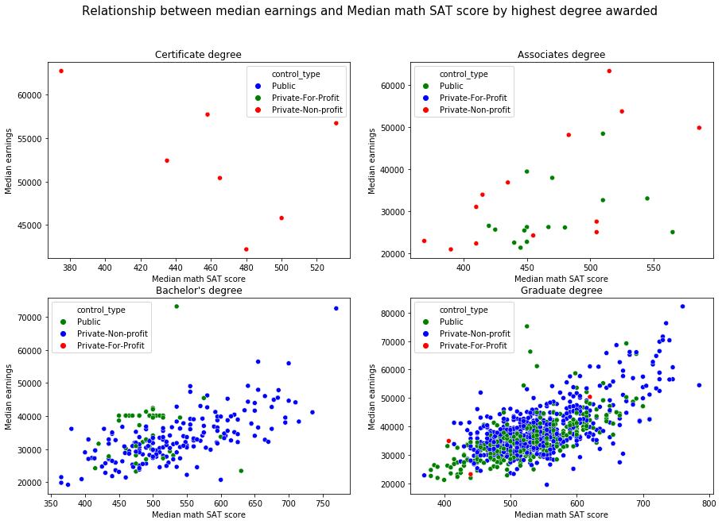
EDA - SAT math score
Higher SAT math scores on average are associated with higher median earnings particularly among institutions whose highest degrees offered is a Bachelor’s or Graduate degree

Slide 9
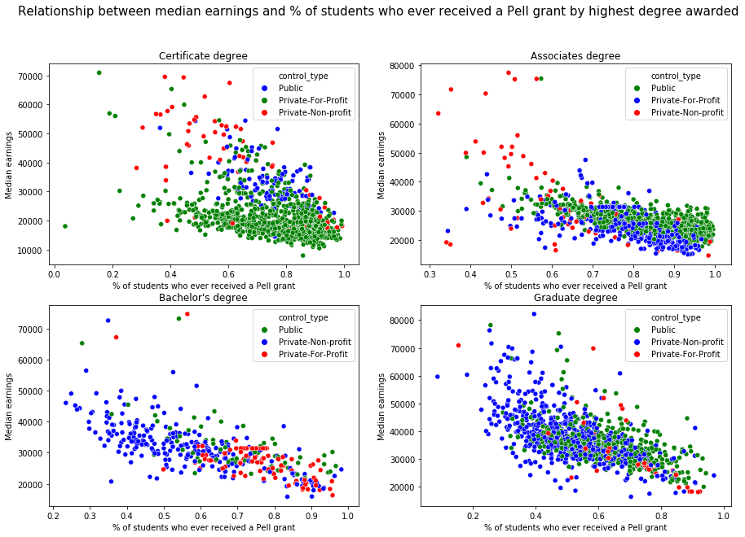
EDA - Share of students who receive a Pell grant
On average, across all institution types, a higher share of students whose have received a Pell Grant, awarded to students with exceptional financial need, the lower the median earnings on average

Slide 10
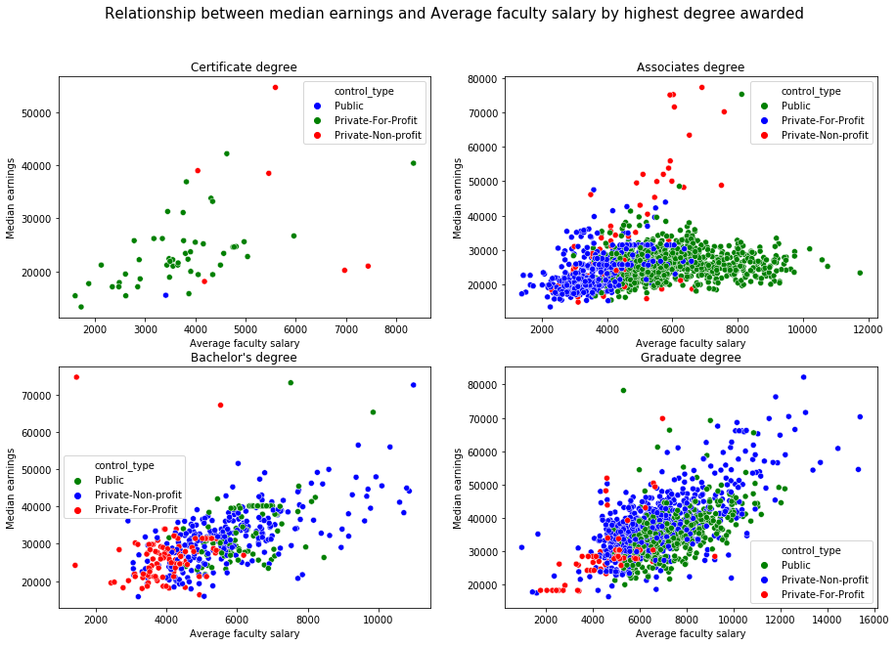
EDA - Average faculty salary
On average, the higher the faculty salary the higher the median earnings post graduation particularly among institutions whose highest degree awarded is Bachelor’s or a Graduate degree

Slide 11
Data Filtering
Highly specialized institutions such as medical and law schools and theological seminaries were removed from the data set as they are not comparable with many other institutions and their missions, in the case of faith-oriented institutions, may not be to maximize some of the metrics considered in this analysis such as post graduation wages
Institutions located outside of the 50 states were removed from the data set
Simple median imputation was used to impute missing data after checking the results of a KNN and iterative imputers

Slide 12
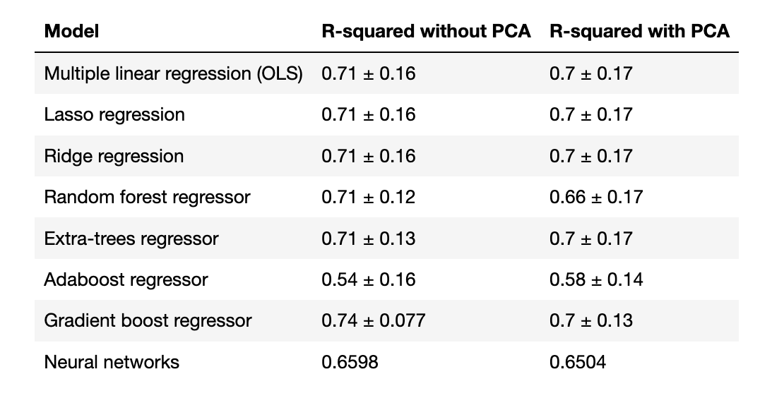
Model Selection - Median Earnings
PCA was implemented for dimensionality reduction
Null model R-squared is 0
Gradient boost regressor produced the highest R-squared score

Slide 13
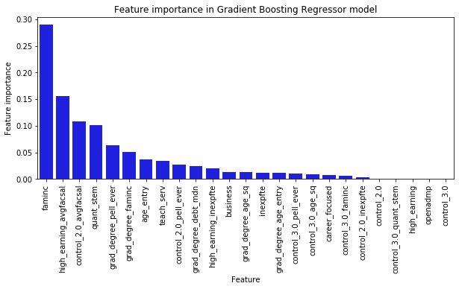
Feature importance in Gradient Boost Regressor
Family income, average faculty salary, the share of degrees awarded in quantitative STEM fields contribute to the prediction of median earnings while an indicator for an open admissions policy does not

Slide 14
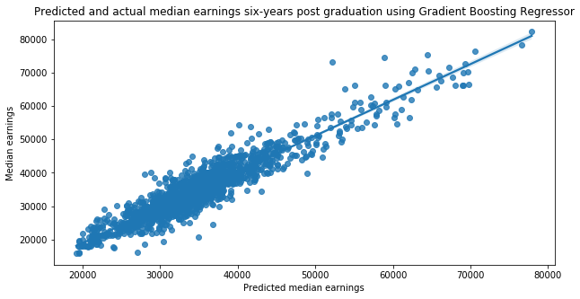
Median earnings predictions

Slide 15
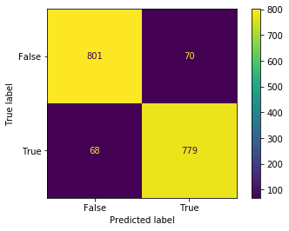
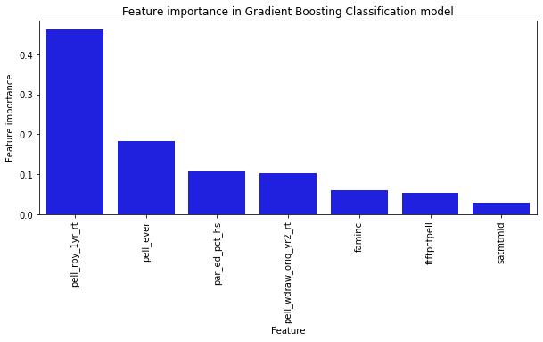
Model Selection - Classification of default rates above national median
Using a Gradient Boost Classifier, the precision and recall scores based on the confusion matrix are above 90%
The most important features in the classification model are:
One-year repayment rate for students who received a Pell grant while at the school
Share of students who have received a Pell grant
Share of students whose parents’ highest level of education is high school

Slide 16
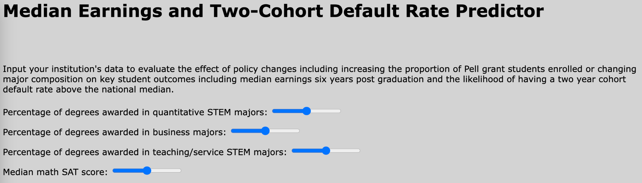
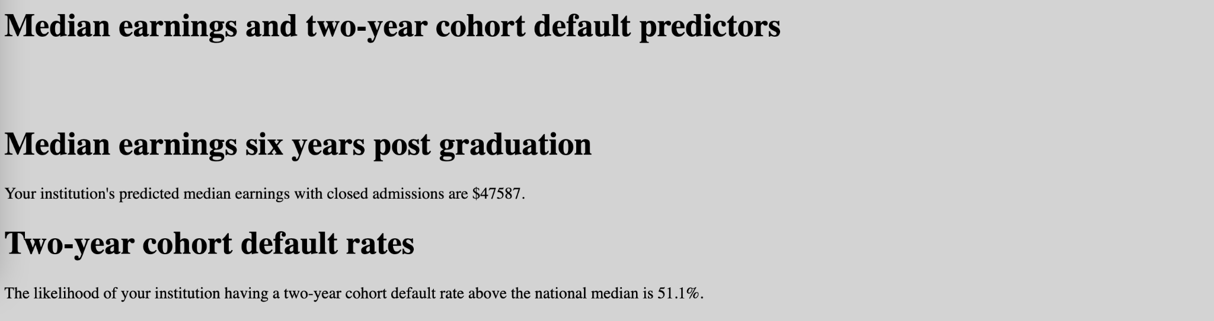
Flask App
In this app an user can adjust model input values and visualize the effect of the input or policy changes on the state accountability metrics

